Slide 1
RUN, SCOTTY!
The Athletes
BIlly zhu, the insufficient
Reid long, the nearsighted
Teddy ding, the awkward
And tianyu li, the UNREASONABLE

Slide 2
BREATH-TAKING RPG

Slide 3
FEATURING 1ST-TIER GRAPHICS FROM…

Slide 4


Featuring…

Slide 5

Actually…

Slide 6

Never Mind…

Slide 7

You know what…

Slide 8
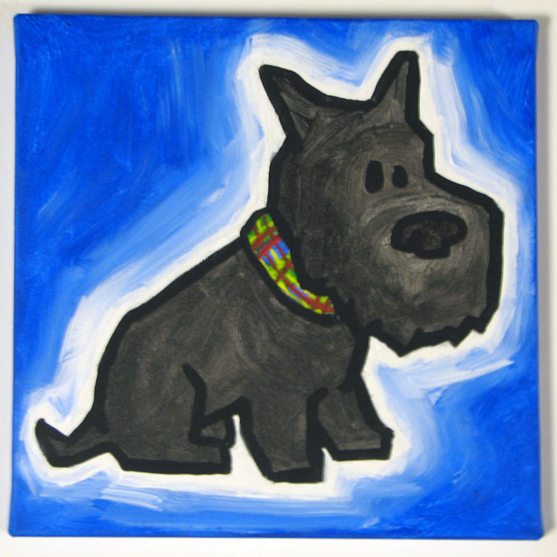

Scotty Evil MIT Students
VS.

Slide 9
Mechanism
Player controls Scotty and places “the fence.”
Evil MIT students, driven by our powerful AI algorithm, chases Scotty.
Seamlessly displayed on an open screen. No Restriction. Pure Challenge.

